Slide 1
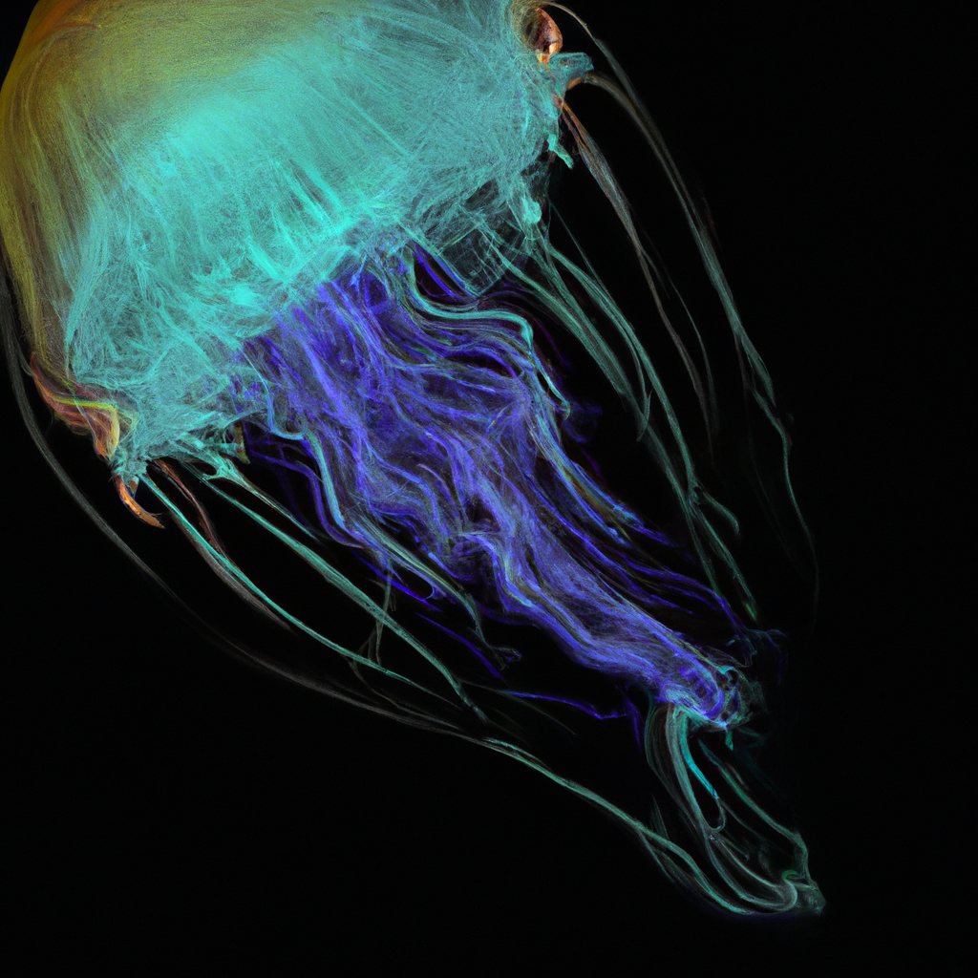
"Exploring the World of Jellyfish: Characteristics and Habitat"
- Title: Understanding Jellyfish
- Also known as medusas or sea jellies
- Inhabit the world's oceans
- Belong to the phylum Cnidaria
- Characterized by gelatinous bodies and tentacles

Slide 2
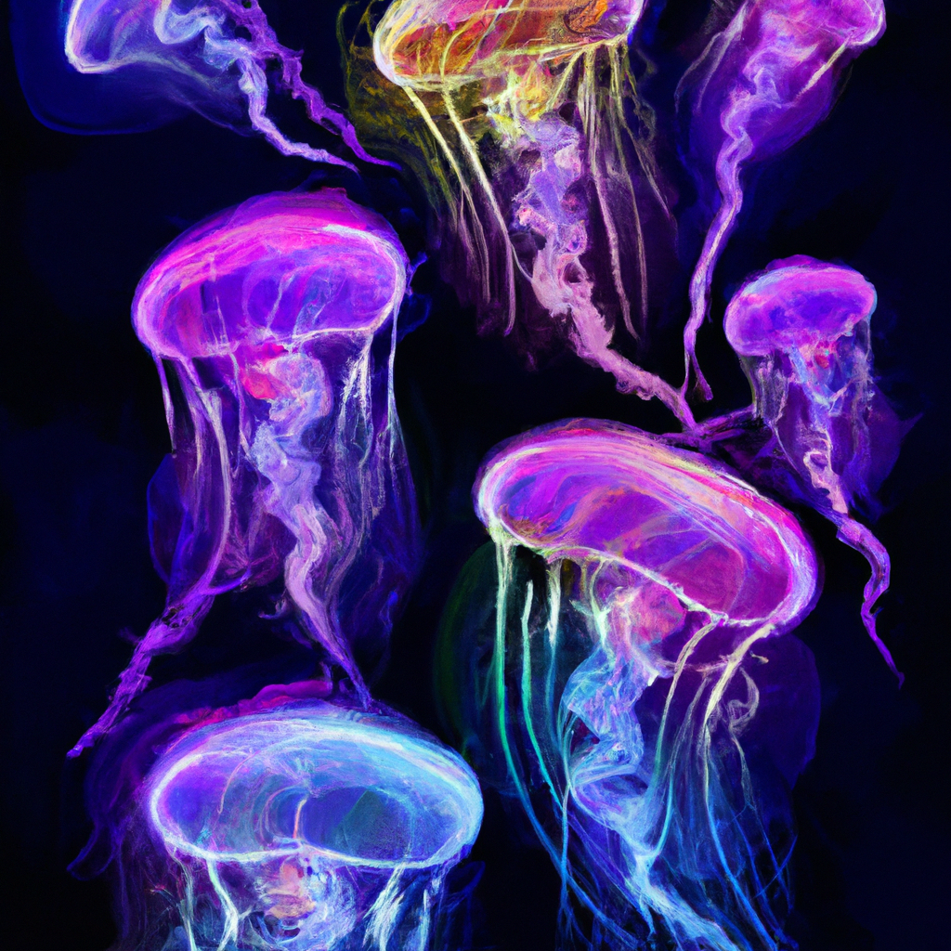
"Understanding the Diversity and Life Cycle of Jellyfish"
• Jellyfish Varieties: Diverse in shape, size, and color, from small and transparent to large and vibrant
• Unique Life Cycle: Begin as a polyp attached to the ocean floor
• Transformation: Evolve into a free-swimming medusa phase

Slide 3
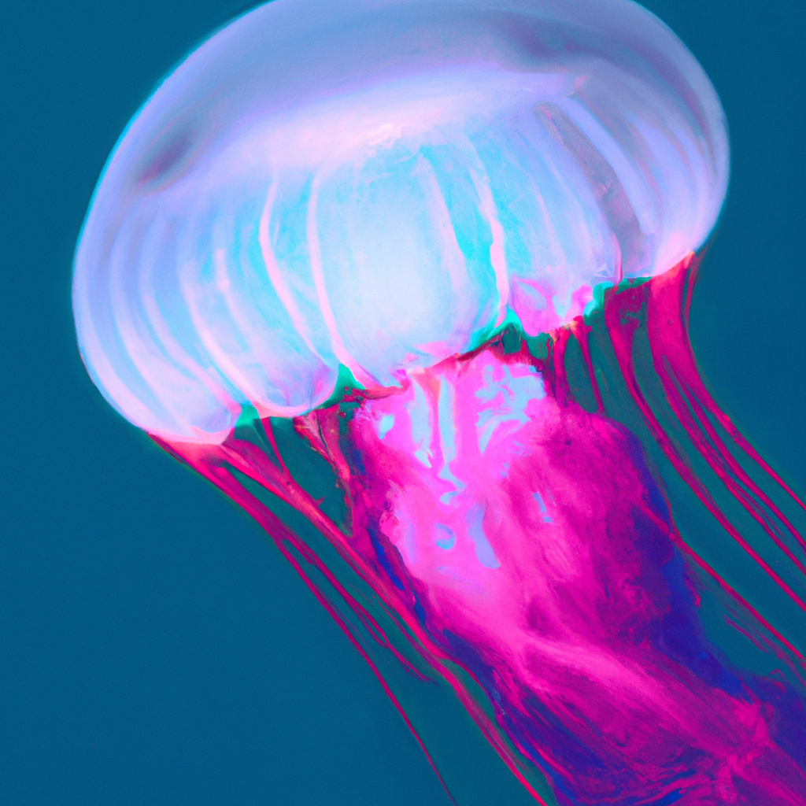
"Understanding the Sting: The Defense and Hunting Mechanisms of Jellyfish"
- Intriguing aspect: Jellyfish's ability to sting
- Specialized cells: Cnidocytes contain nematocysts for venom delivery
- Use of stinging cells: Capture prey and defense against predators
- Impact on humans: Most stings harmless, but some species can cause pain or danger
- Advice: Exercise caution when swimming in jellyfish-populated waters

Slide 4
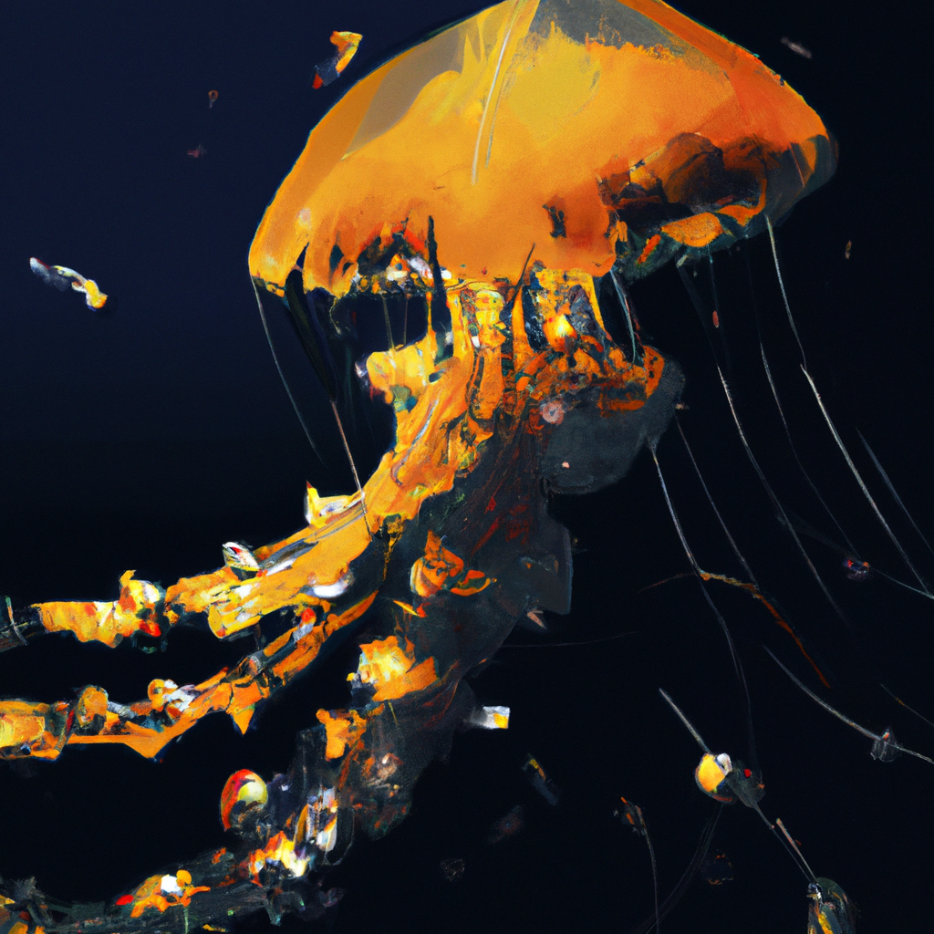
"Significant Roles and Adaptive Abilities of Jellyfish in Marine Ecosystems"
• Important roles of Jellyfish in marine ecosystems.
• Opportunistic feeders: Consume small planktonic organisms, fish eggs, and other jellyfish.
• Maintain balance in the marine food web as predators.
• Unique ability to adapt to changing environmental conditions.

